Slide 1
The Connected Leader - - - Storytelling
WELCOME TO…
Tim Van Ness

Slide 2
The Connected Leader?
WHY…

Slide 3
“Connection is why we’re here. It’s what gives purpose and meaning to our lives. In order for connection to happen, we have to allow ourselves to be seen.” - Brene Brown
The Connected Leader - Storytelling

Slide 4
Connecting with others through how we communicate can help build trust and collaboration and allow a school community to increase student success.
The Connected Leader - Storytelling

Slide 5
The Connected Leader - Storytelling
What does it mean to
Connect
or be
Connected?
{CHAT!]

Slide 6
How?
The Connected Leader - Storytelling

Slide 7
THE CONNECTED COMMUNICATOR
MODEL
Connect with
YOURSELF

Slide 8
THE CONNECTED COMMUNICATOR
MODEL
THE CONNECTED COMMUNICATOR
MODEL
Connect with
YOURSELF
Connect with
YOUR CONTENT

Slide 9
THE CONNECTED COMMUNICATOR
MODEL
Connect with
YOURSELF
Connect with
YOUR CONTENT
Connect with
YOUR AUDIENCE

Slide 10
THE CONNECTED COMMUNICATOR
MODEL
Connect with
YOURSELF
Connect with
YOUR CONTENT
The Zone
Connect with
YOUR AUDIENCE

Slide 11
THE CONNECTED COMMUNICATOR
MODEL
Connect with
YOURSELF
Connect with
YOUR CONTENT
The Zone
the
Zone
of
Authentic
Connection
Connect with
YOUR AUDIENCE

Slide 12
The Connected Leader - Storytelling
Connect with
YOURSELF

Slide 13
The Connected Leader - Storytelling
Quietly to yourself, think of a time when you felt fully connected– at least to yourself, if not with yourself, your content and your audience.
What were the conditions that created the environment for you to feel that connected?
Connect with
YOURSELF

Slide 14
The Connected Leader - Storytelling
Conditions for Connection
Being in Nature Collaboration, working on common goals
Exercise Doing something you enjoy, confident in
Good food Understanding your investment
Good work Agreed upon boundaries
Fun Withholding Judgment
Family Being true to your values
Close friends Breathing
Curiosity Stretching myself
Listening w/ your heart Gratitude
Shared process Unconditional positive regard
Being of service Self care
Something beyond “me” - spiritual/magical

Slide 15
The Connected Leader - Storytelling
Thoughts

Slide 16
The Connected Communicator
Thoughts
Feelings

Slide 17
The Connected Communicator
Thoughts
Feelings
Actions

Slide 18
The Connected Communicator
Thoughts
Feelings
CC
Actions

Slide 19
The Connected Communicator
Thoughts
Feelings
CC
Congruently
Connected
Actions

Slide 20
Leadership Storytelling?
WHY…

Slide 21
The Connected Leader - Storytelling
A leadership story is first a story of self, a story of why I’ve been called.
Some people say, “I don’t want to talk about myself,” but if you don’t interpret to others your calling and your reason for doing what you’re doing, do you think it will just stay uninterpreted?
No. Other people will interpret it for you. You don’t have any choice if you want to be a leader.
You have to claim authorship of your story and learn to tell it to others so they can understand the values that move you to act, because it might move them to
act as well!
Marshall Ganz
Kennedy School of Government
Harvard Graduate School of Education

Slide 22
The Connected Leader - Storytelling
Purposes of stories as a teacher/school leader
Share “Why I do what I do”
Build Community
Rally people around a cause and inspire them to action
From Marshall Ganz
Create urgency-help people find their passion through yours (Jennifer Bejarano!)
Offer hope
Help people feel together (solidarity)
Help people to feel personal agency (you can make a difference)
Help people feel dissatisfaction with the status quo

Slide 23
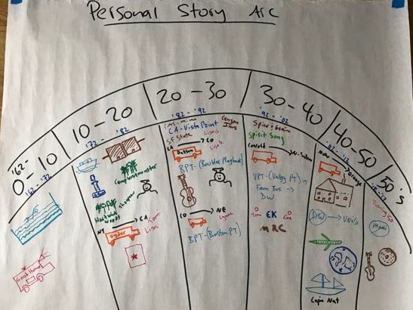
The Connected Leader - Storytelling

Slide 24
The Connected Leader - Storytelling
Solo Self Reflection - Draw your Personal Story Arc
Separate the arc into either 5 or 10-year segments: 0-5, 5-10, 10-15, etc.
If you’re under 30, do 5-year segments.
If you’re over 40, do 10-year segments.
If you’re between 30-40 you choose which to do.
For each segment, write down key moments or turning points* in that segment. I encourage you to write down least one, or as many as you like.
If possible, notate them as pictures (even stick figures) and/or bullet points. Represent at least one as a picture, image or icon (think emoticons!).
Consider people, places, changes, events, etc.

Slide 25
The Connected Leader - Storytelling
A Turning Point or a Key Moment…
Is a time in your life in which something happened that defines part of who you are, what is important to you, who you are at your core, how a core value was defined, etc.
It might be meeting an important person for the first time.
It might be a significant change, or transition.
It might be the experience of a particular place.
It might inform the questions, “How did I get to where I am today? Why am I the person I am today? What has made me the leader I am today?”

Slide 26
The Connected Leader - Storytelling
Structure of a good story
Beginning
Turning
Ending

Slide 27
The Connected Leader - Storytelling
What makes a good story?

Slide 28
The Connected Leader - Storytelling
Key Storytelling techniques
Create suspense or tension
Tell in the present tense
Sensory Details – sights, smells, sounds, etc.
Short sentences – lots of “periods”, vs. commas, elipsis, etc.
Vocal Variety – characters, voices, etc.
Physically embody the story – re-live the moment!

Slide 29
Thank You!
Programs for groups • Coaching for individuals • Consulting for organizations
Live your Values • Develop your leaders • Improve your culture
www.vn-co.com

