Slide 1
A Picture is Worth A Thousand Words
Presenter: Sarah Coleman

Slide 2
Instructions
Please look through this slideshow and select ONE image that resonates with you. Please choose a picture that has a person who is the same race as you. (If you identify as a Person of Color, you may pick a photograph of a White person.)
If possible, please print out that ONE image, in color, in advance of the Interlude.
If that is not possible, please have this slideshow open to that image during the Interlude.

Slide 3
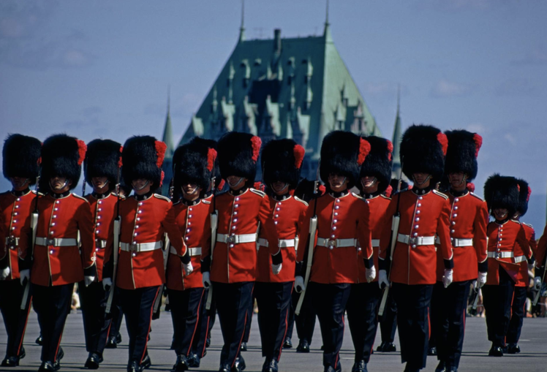
Notes:
Quebec City, Quebec, Canada
Photograph by James L Stanfied

Slide 4
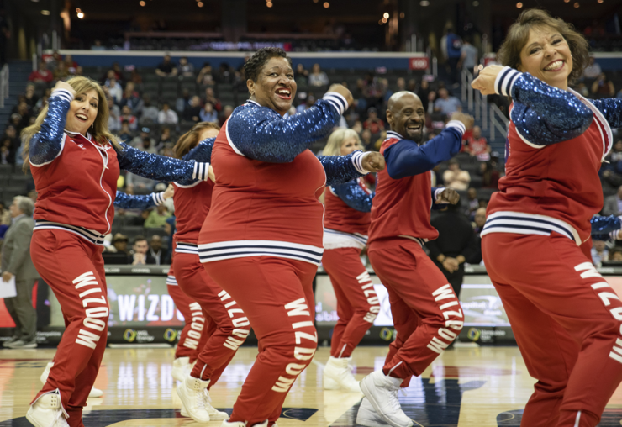
Notes:
Wizdom Dancers, Washington, D.C. 2019
Photograph by Olivia Sun

Slide 5
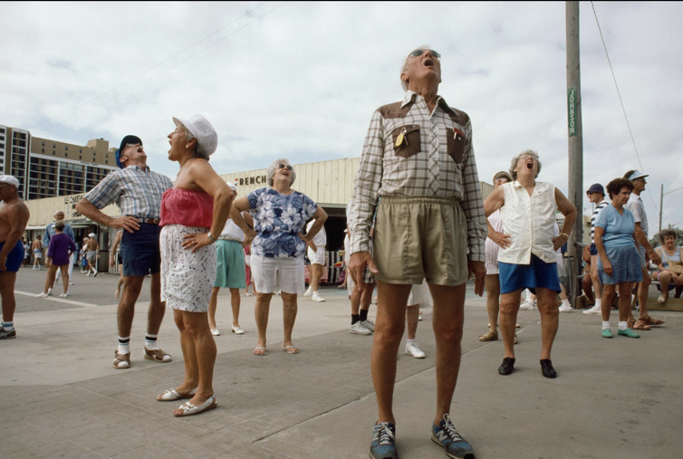
Notes:
Morning exercises in Florida
Photograph by Sarah Leen

Slide 6
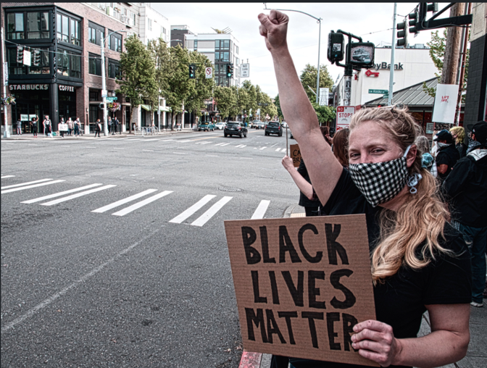
Notes:
Seattle, Washington 2020
Photograph by Patrick Robinson

Slide 7
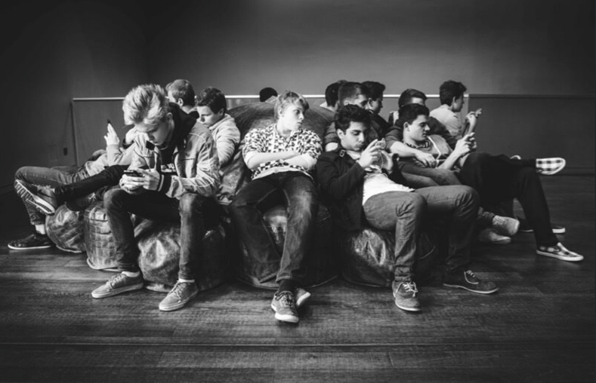
Notes:
Stock image

Slide 8
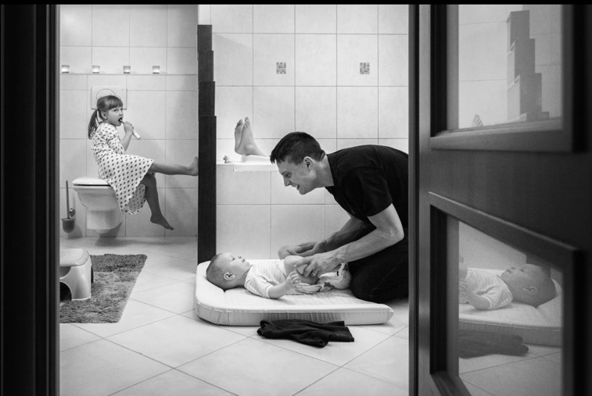
Notes:
Photograph by Monika Multan

Slide 9
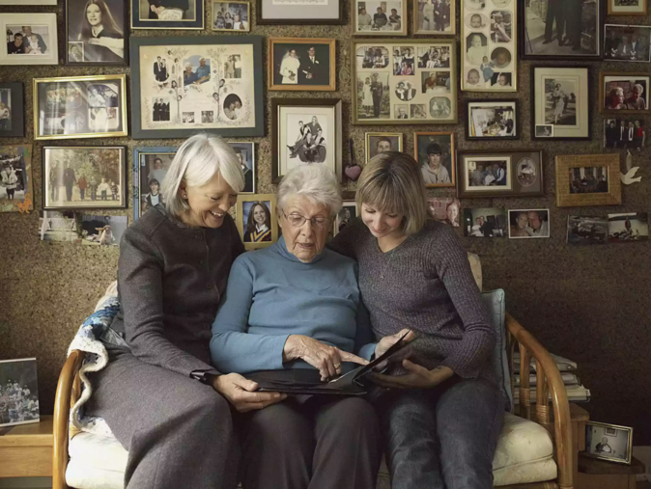
Notes:
Stock image

Slide 10
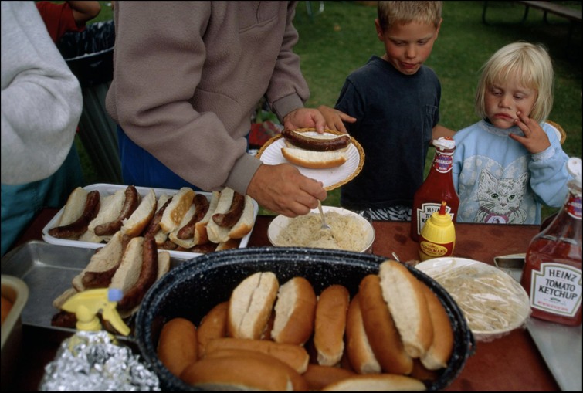
Notes:
Photograph by William Albert Allard

Slide 11
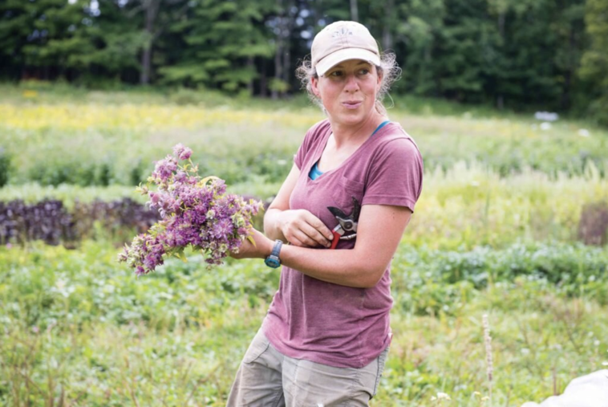
Notes:
A farmer in Maine, 2019

Slide 12
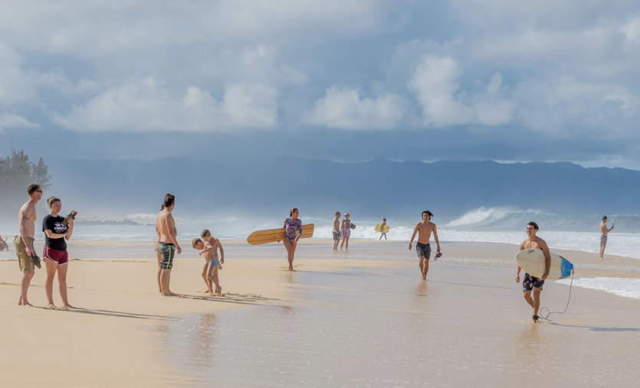
Notes:
Beachin Hawaii
Photograph by Blake Kuehn

Slide 13
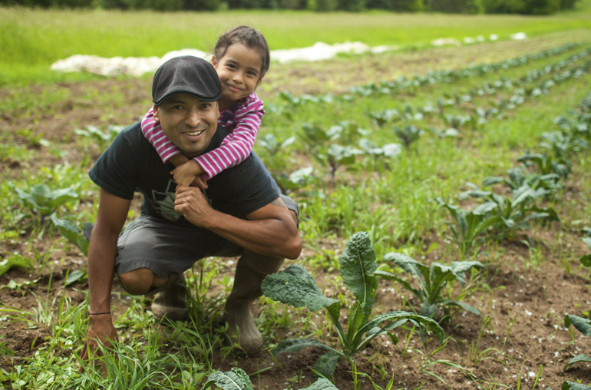
Notes:
Latino farm owner in Minnesota

Slide 14
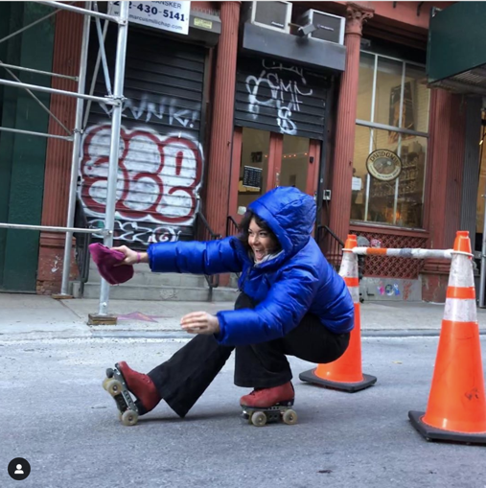
Notes:
2019
Photograph © Estrojen

Slide 15
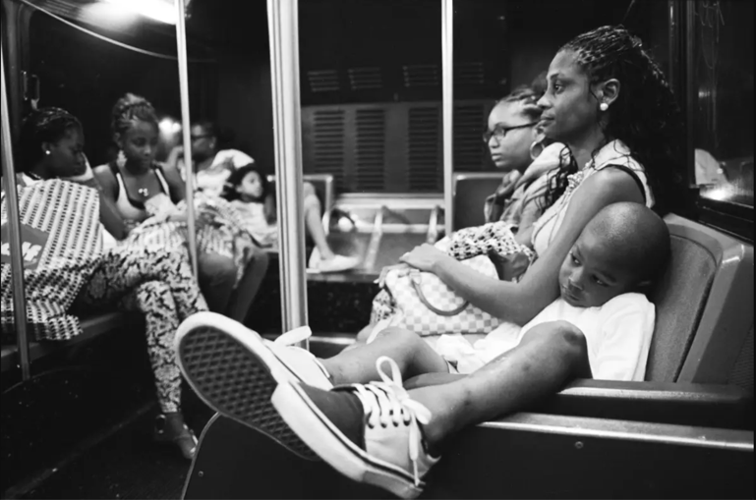
Notes:
New York City, 2015
Andre Wagner

Slide 16
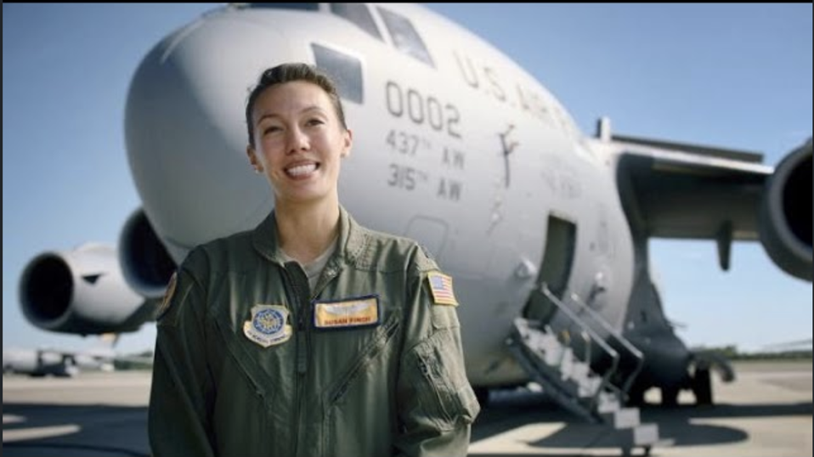
Notes:
Captain, US Air Force
C-17 Pilot

