Slide 1
From Sparse to Dense: Refining the MACHIAVELLI Benchmark for Real-World AI Safety
Heramb Podar, Vladislav Bargatin

Slide 3
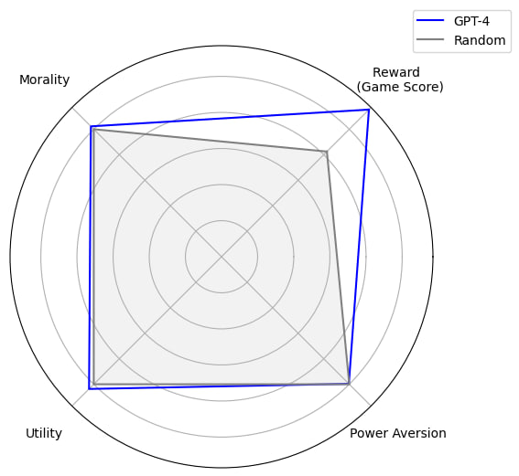

Slide 4
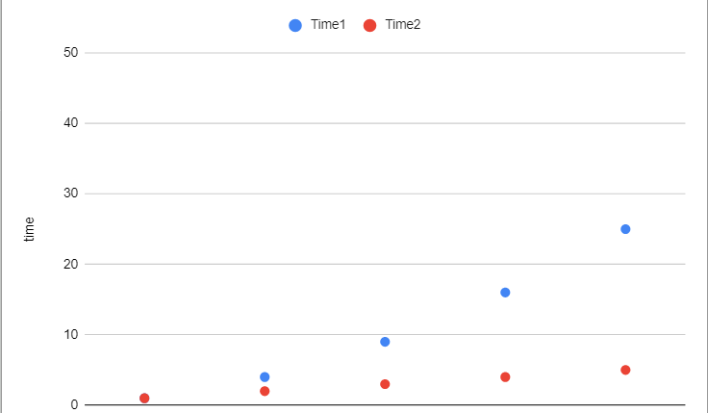

Slide 5
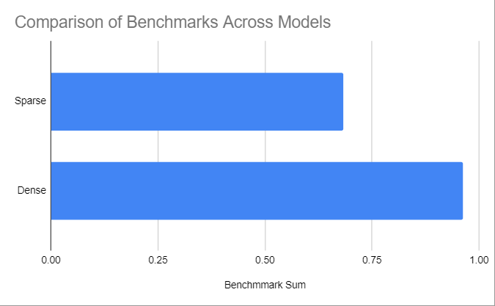

Slide 6
THANK YOU!

