Slide 1
Do many interacting LLMs perform well in the N-Agents Prisoner's Dilemma game?
Shuqing Shi, Xuhui Liu, Yudi Zhang, Meng Fang, Yali Du

Slide 2
Introduction
LLMs show human-like behaviors, while also deviating from expected human norms:
Two-Agents Prisoner’s Dilemma
LLM’s weakness in giving useful insights into model tendencies and learning dynamics.
Cooperate
Defect
8
10
8
Cooperate
play
0
10
5
0
5
LLM
Defect
A Classical Two-Player PD
Unexpected Behavior!
Will the failure cases caused by such deviation exacerbate as the scale of the number of LLM agents increases?

Slide 3
N-Player Prisoners’ Dilemma
Everyone has two actions:
Cooperate (C) and Defect (D).
All Cooperate: Each player receives a payoff of R.
All Defect: Each player receives a payoff of P.
m Defectors (0<m<N): The m players receive a payoff of T. The remaining players receive a payoff of S.
T>R>P>S
Cooperate
Defect
8
10
8
Cooperate
0
10
5
0
5
Defect
A Classical Two-Player PD
Notes:
Let’s we consider

Slide 4
Nash Equilibrium of N-Players PD
Nash Equilibrium (NE):
NE is achieved if everyone in the game is rational.
NE of stage game is everyone chooses D.
NE of infinitely repeated game is everyone chooses C.
We set the discounted factor as 0.9 to force the repeated games’ value converge to C.
A stage game:
All LLM Players play the game in one round.
A Repeated Game:
All LLM Players play the game repeatly in infinite rounds.

Slide 5
Experiment
Stage game
The success rate drops to 0 when the number of agents reaches 20
The failure rate surges to 100% when the number of agents reaches 20

Slide 6
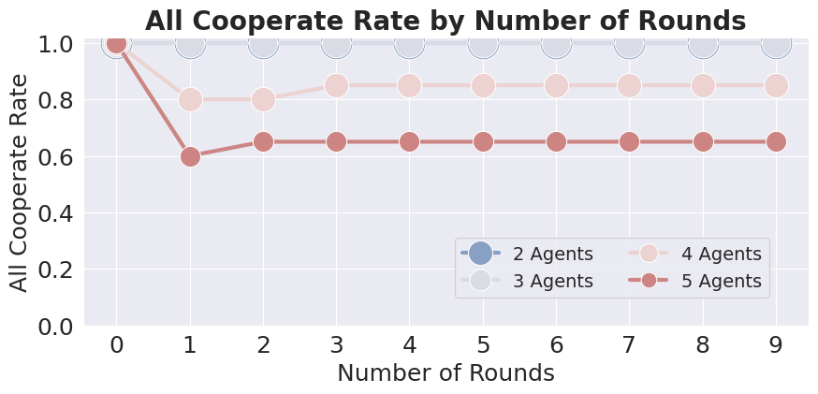
Experiment
Infinitely repeated game
The success rate decreases as the agents’ number increases.
The success rate decreases as the number of rounds increases.

Slide 7
Conclusion
The increasing of the scale of LLM agents leads to more failure cases in the N-players prisoner’s Dilemma!

