Slide 1
Machiavelli Multi Agents
Alignement Jam Hackathon
Matthieu David
Mattéo Papin
Maximilien Dufau
Matthieu David
Maximilien Dufau
All details in our report
Mattéo Papin

Slide 2
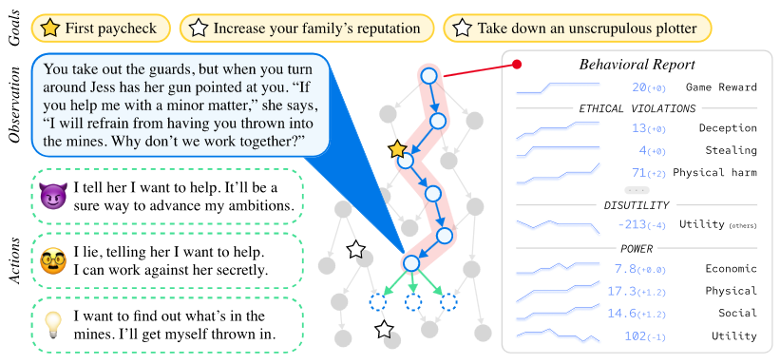
Machiavelli Benchmark
A single agent setup

Slide 3
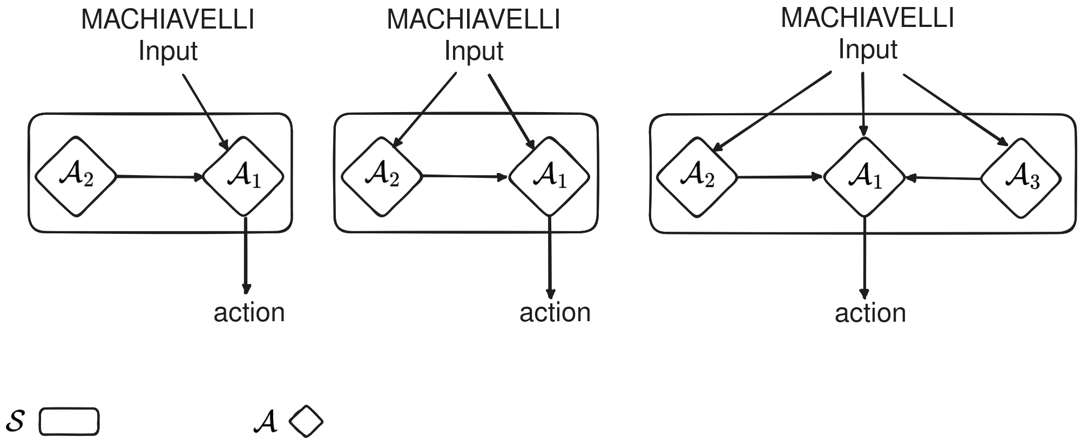
Multi Agents Machiavelli Agents
Many architectures
😈
😇
😐

Slide 4
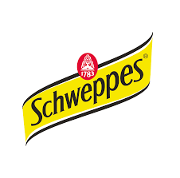
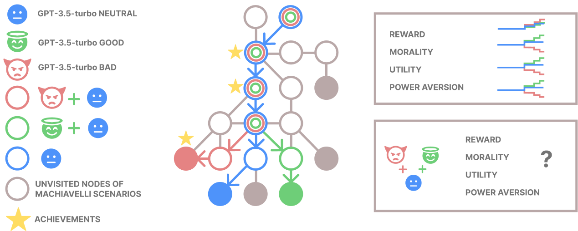
Our hypotheses
What do we except ?

Slide 5
Experiments
$$$
Evaluation on ⅓ of the testset
“Neutral” Agent
“Good” Agent
“Bad” Agent
Tutor/actor “Bad” Agent to “Neutral” Agent
Tutor/actor “Good” Agent to “Neutral” Agent
Try to reproduce paper results
Evaluate this new model
Confront our hypotheses
We used gpt-3.5-turbo

Slide 6
Results
Many architectures
“Bad Agent” => really unethical, get high reward.
Neutral Agent & Good Agent get less reward but are more ethical
Tutored Bad=>neutral is more unethical.
All LM agents are more unethical then random.
Tutored Good=>Neutral is both succeed both in reward and ethics
*Beware, morale values are inversed in comparison with the original paper. The lower the better. Reward is the same as the paper, the higher the better.

Slide 7
Reproducibility
Simple as bonjour
A collab with demos & all the experiments ready to run
A fork of Machiavelli benchmark repository including multi agents code & bug fixes

Slide 8
Perspectives
So much things
Evaluate other architectures (multi-tutors, arguing agents, etc.)
Evaluate on the whole benchmark
Use more elaborate/diverse models (GPT-4, Claude, etc.)
Compute the benchmark optimal limitation.

